Slide 1
The Noise Pollution (Regulation & Control)
Rules, 2000
Dr. Kalpeshkumar L Gupta
Founder – ProBono India
www.probono-india.in

Slide 2
What is Noise ?
The expression “noise” has not been defined statutorily. But, the expression “noise” was inserted into the Air (Prevention & Control of Pollution) Act, 1981 by the Amendment Act.
“air pollutant” means any solid, liquid or gaseous substance including noise present in the atmosphere in such concentration as may be or tend to be injurious to human being or other living creatures or plant or property or environment.”

Slide 3
What is Noise Pollution ?
Noise Pollution means defilement of atmosphere due to sound. In other words disturbing the atmosphere by means of sound.
Recent studies reveal that a prolonged exposure to noise levels above 90 decibles can cause permanent deafness. Researcher are of opinion that if the present noise levels continue unfettered, future generation may be born deaf and dumb.

Slide 4
Causes of Noise Pollution
1. Natural noise pollution
2. Man-made noise pollution

Slide 5
Causes of Noise Pollution
1. Natural noise pollution
In this category of noise pollution, air, seas, volcanoes, rivers and exchanging voices of living organs.

Slide 6
Causes of Noise Pollution
2. Man-made noise pollution
This category of noise pollution is caused by machines, automobiles, trains, aero planes, social and religious celebration, speeches, construction works and other modern equipments.

Slide 7
Kinds of Noise Pollution
Industrial Noise Pollution
Urban Noise Pollution
Rural Noise Pollution

Slide 8
Kinds of Noise Pollution
1. Industrial Noise Pollution
The noise pollution produced due to industrial activities is called industrial noise pollution. In recent decades enormous industrialization has taken place which created noise pollution from industrial sources. Most of the Indian cities are suffering from industrial noise pollution.

Slide 9
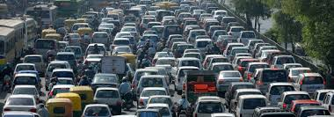
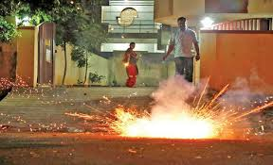
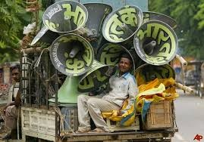
Kinds of Noise Pollution
2. Urban Noise Pollution
The noise pollution created by automobiles, cultural programmes, festivals, advertisement and loudspeakers are the most significant urban noise pollution.

Slide 10
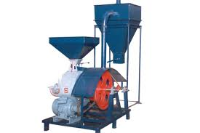
Kinds of Noise Pollution
3. Rural Noise Pollution
The noise pollution created due to use of pumping sets, flour mills and religious gathering in rural areas is called rural noise pollution. However, rural noise pollution generates least hazard in comparison with the industrial and urban noise pollution.
The Allahabad HC in Radhey Shyam v/s. Guru Prasad (AIR 1978 All. 86), issued injunction against the defendant, restraining him from running a flour-mill on the ground of causing additional noise in an already noisy area.

Slide 11
Noise Pollution Rules
Dt. 14-2-2000
Whereas the increasing ambient noise levels in public places from various sources, inter alia, industrial activity, construction activity, generator sets, loud speakers, public address systems, music systems, vehicular horns and other mechanical devices have deleterious effects on human health and the psychological well being of the people, it is considered necessary to regulate and control noise producing and generating sources with the objectives of maintaining the ambient air quality standards in respect of noise.

Slide 12
Noise Pollution Rules
Now, therefore, in exercise of the powers conferred by clause (ii) of sub-section (2) of Section 3, sub-section (1) and clause (b) of sub-section (2) of Section 6 and Section 25 of the Environment (Protection) Act, 1986 read with
Rule 5 of the Environment (Protection) Rules, 1986, the Central Govt. hereby makes the followings rules for the regulation and control of noise producing and generating sources.

Slide 13
Section 3 :- Ambient Air Quality Standards in respect of noise for different areas/zones
The ambient air quality standards in respect of noise for different areas/zones shall be such as specified in the Schedule annexed to these rules.
The state govt. shall categorize the areas into industrial commercial, residential or silence area/zone for the purpose of implementation of noise standards for different areas.
The state govt. shall take measures for abatement of noise including noise emanating from vehicular movements and ensure that the existing noise levels do not exceed the ambient air quality standards specified under these rules.

Slide 14
Section 3 :- Ambient Air Quality Standards in respect of noise for different areas/zones
All development authorities, local bodies and other concerned authorities while planning development activity or carrying out functions relating to town and country planning shall take into consideration all aspects of noise pollution as a parameter of quality of life to avoid noise menace and to achieve the objective of maintaining the ambient air quality standards in respect of noise.
An area comprising not less than 100 metres around hospitals, educational institutions and courts may be declared as silence area/zone for the purpose of these rules.

Slide 15
Schedule (See Rule 3(1) and (4)
Area Code | Category of Area/Zone | Limits in dB (A) Leq*
 |  | Day Time | Night Time
A | Industrial Area | 75 | 70
B | Commercial Area | 65 | 55
C | Residential Area | 55 | 45
D | Silence Zone | 50 | 40
Note :-
1. Day time shall mean from 6:00 am to 10:00 pm
2. Night time shall mean from 10:00 to 6:00 am
3. Silence Zone is an area comprising not less than 100 metres around hospitals, educational institutions, courts, religious places or any other area which is declared as such by the competent authority.
*dB(A) Leq denotes the time weighted average of the level of sound in decibles on scale A which is relatable to human hearing.
A “decible” is a unit in which noise is measured.
“A” in dB(A) Leq, denotes the frequency weighting in the measurement of noise and corresponds to frequency response characteristics of the ear.
Leq: It is an energy mean of the noise level over a specified period.

Slide 16
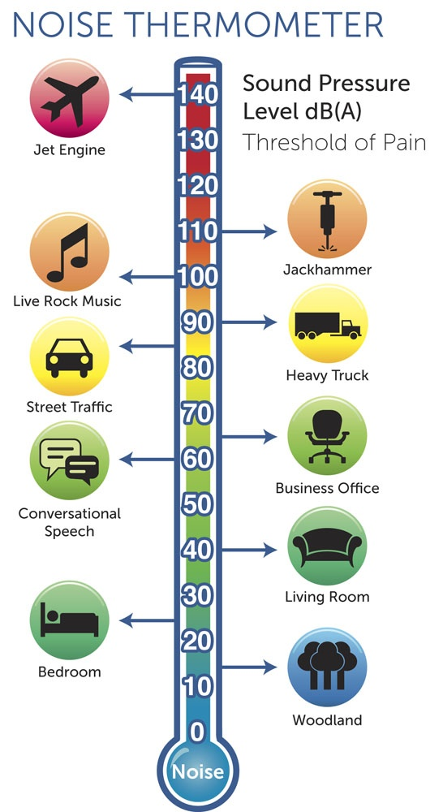

Slide 17
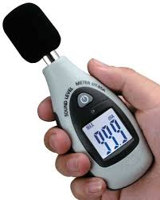
Digital Sound Level Meter

Slide 18
Section 4 :- Responsibility as to enforcement of noise pollution
The noise levels in any area/zone shall not exceed the ambient air quality standards in respect of noise as specified in the Schedule
The authority shall be responsible for the enforcement of noise pollution control measures and the due compliance of the ambient air quality standards in respect of noise.
Authority (Section 2(c)) means and includes any authority or officer authorized by the central govt. or as the case may be, the state govt. in accordance with the laws in force and includes a District Magistrate, Police Commissioner, or any other officer not below the rank of the Deputy SP designated for the maintenance of the ambient air quality standards in respect of noise under any law for the time being in force.

Slide 19
Section 5 :- Restrictions on the use of loud speakers/public address system
A loud speaker or a public address system shall not be used except after obtaining written permission from the authority.
A loud speaker or a public address system shall not be used at night (between 10-00 pm to 6-00 pm) except in closed premises for communication within, e.g. auditorium, conference rooms, community halls and banquet halls.

Slide 20
Section 6 :- Consequences of any violation in silence zone/area.
Whoever, in any place covered under the silence zone/area commits any of the followings offence, he shall be liable for penalty under the provisions of the act.
Whoever, plays any music or uses any sound amplifiers.
Whoever, beats drum or tom-tom or blows a horn either musical or pressure or trumpet or beats or sounds any instrument or
Whoever, exhibits any mimetic, musical or other performances of a nature to attract crowds.

Slide 21
Section 7 :- Complaints to be made to the authority
A person may, if the noise level exceeds the ambient noise standards by 10 dB (A) or more given in the corresponding columns against any area/zone make a complaint to the authority.
The authority shall act on the complaint and take action against the violator in accordance with the provisions of these rules and any other law in force.

Slide 22
Section 8 :- Power to prohibit etc., continuance of music sound or noise.
- If the authority is satisfied from the report of an officer incharge of a police station or other information received by him that it is necessary to do so in order to prevent annoyance, disturbance, discomfort or injury or risk of annoyance, disturbance, discomfort or injury to the public or to any person who dwell or occupy property on the vicinity, he may by a written order issue such direction as he may consider necessary to any person for preventing, prohibiting, controlling or regulating :-
a. The incidence or continuance in or upon any premises of
- Any vocal or instrumental music
- Sounds caused by playing, beating, clashing, blowing or use in any manner whatsoever of any instrument including loudspeakers, public address systems, appliance or apparatus or contrivance which is capable of producing or re-producing sound, or

Slide 23
Section 8 :- Power to prohibit etc., continuance of music sound or noise.
-The authority empowered under sub-rule (1) may, either on its own motion, or on the application of any person aggrieved by an order made under sub-rule (1), either rescind, modify or alter any such order.
Provided that before any such application is disposed of, the said authority shall afford to the applicant an opportunity of appearing before it either in person or by a person representing him and showing cause against the order and shall, if it reflects any such application either wholly or in part, record its reasons for such rejection.

Slide 24
Constitution of India : Noise Pollution
There is no whisper of “noise” or “noise pollution” as such in the Constitution of India.
However during festivals like Diwali, Dushera, Holi, Idd and Christmas etc. including family programmes like marriage and birthday, the Indian people developed tradition to create noise by use of high intensity microphones and loudspeakers etc.
These ingredients are enormous source of noise pollution.

Slide 25
Constitution of India : Noise Pollution
Maulana Mufti Syed Md Noorur Rehman Barkati & Ors v/s. State of Bengal and Ors. (AIR 1999 Cal 15)
Calcutta HC observed that use of microphone is of recent origin and accordingly it could not be said that the use of microphone and loudspeakers are essential and intergral part of the religion.
The court further held that use of loudspeakers and microphones in Azaan is not essential and integral part of any religion hence there is no violation of right to religion guaranteed under Article 25 of the Constitution of India.

Slide 26
Constitution of India : Noise Pollution
Church of God in India v/s. K K R Majestic Colony Welfare Association & Ors. (AIR 2000 SC 2773)
SC held that no religion prescribes that prayers should be performed by disturbing the peace of others. The question involved in this case was whether in a country having multiple religious communities a religious community could claim its right to add to noise pollution on the ground of religion.

Slide 27
Constitution of India : Noise Pollution
Om Biramgama Religious Society v/s. State (1996)
Calcutta HC held that freedom of speech and expression guaranteed under Article 19(1)(a) of the Constitution of India essentially includes freedom not to listen and/or to remain silent. One cannot be permitted to exercise his fundamental right at the cost of others’ health or well being. In the present case the sub-divisional officer rightly directed the petitioner/society not to use any microphone while performing the pooja and other religious activities.

Slide 28
Constitution of India : Noise Pollution
Forum for the Prevention of Environment and Sound Pollution v/s. Union of India (2006 1 MLJ 49 (SC)
SC held that prohibition on use of loudspeaker or public system between 10-00 pm to 12 midnight is not invalid or unconstitutional.

Slide 29
Constitution of India : Noise Pollution
S K Ikram Sheikh Israil v/s. State of Maharashtra (2007 4 SCC 217)
In this case appellants carrying out manufacturing of brass utensils was causing noise pollution affecting the schools and the people of the area. As a result notice to the appellant was issued by the SP directing appellants to stop their activities/business. Before the SC, appellants submitted that they should be given an opportunity to reduce the noise level and take remedial measures.
The SC ruled that in these circumstances, appellants were directed to submit a concrete proposal before the authorities concerned stating how they would stick to the norms.

Slide 30
www.probono-india.in

